Slide 1

TASTE THE YUMMY CHICKEN BURGER
SPECIAL OFFER OF SUMMER SEASON
99/- RS

Slide 2
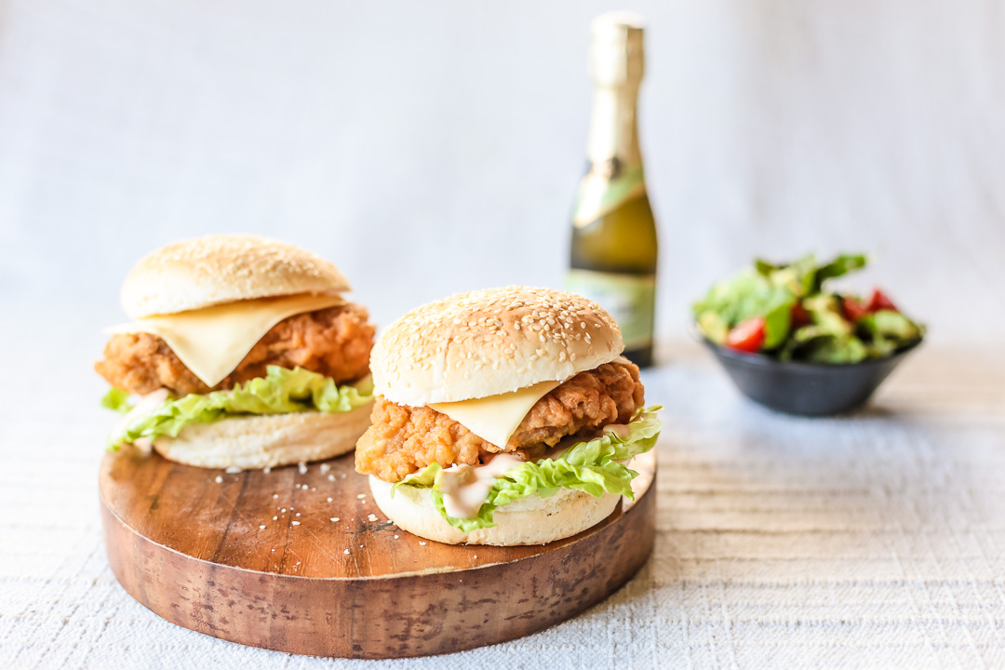
ADDRESS:- ground floor, wbiz, shop no-10 &11, chowk road, near ginger hotel, waked, pune, Maharashtra -411057

